Slide 1

TractorTEK
Shawn Ribaudo
Presented by: Shawn Ribaudo
March 11th, 2022

Slide 2
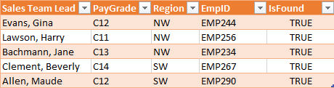
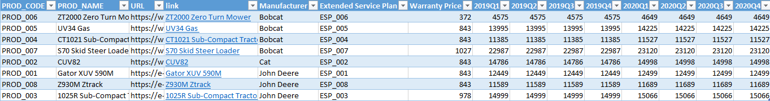
TractorTEK CRASH!
Responsible to restore the TractorTEK Support System
Information about the data
8 products sold by 5 sales team
2 regions (Northwest and Southwest)
Weekly Data for 2 years

Slide 3
Design Database

Slide 4
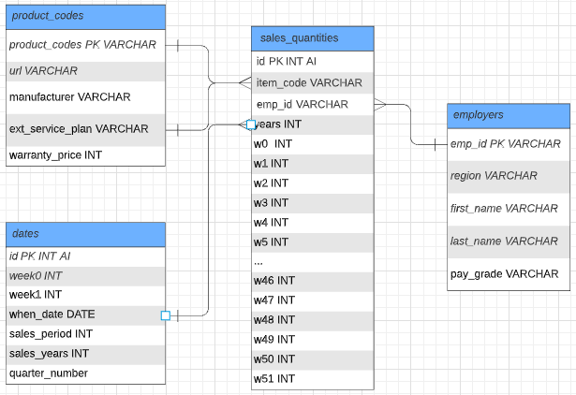
Thought progress
So many possibility
Four Tables
Product codes
Sales quantities
Employers
Dates

Slide 5
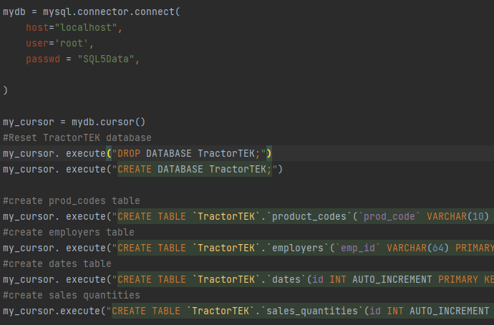
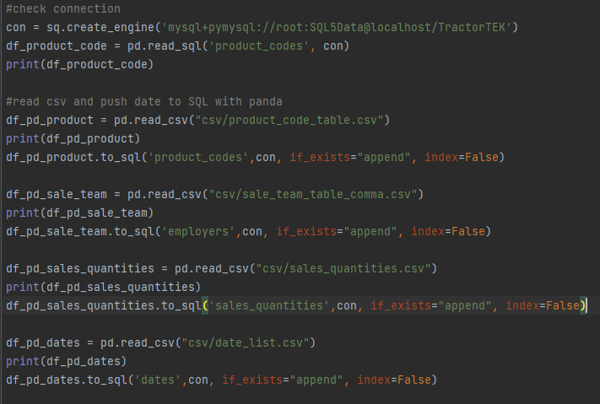
Progress to make a table and feed the data to the database
Code demo

Slide 6
Web App

Slide 7
Detail about the app
A user has a power to add data!
Show all the list from a certain table
Alternative color to make it easier for people eyes to read
Bold table header
Allow user to add data to the database
No input can be negative
Have separate field for character data and number data

Slide 8
Dashboard

Slide 9
Dashboard overview
Focus on manufacturer, region, and salesperson
Dashboard
Let do a demo
Bobcat has the highest sales quantity
NW always get more sales compare to SW
Beverly and Gina always mange to get high sales compare to other employers.
The hype for Extended Service Plan happen during June to Aug.

Slide 10
Quarter 3 is so popular for Extended Service Plan!
Let look at it!
What does tell us?
Quarter 3 = July, August, and September
Most popular time for extended happen during 4th quarter.
Summer
To prepare for the fall
Harvest time
Prepare equipment.

Slide 11
Quarter 1 is so popular for Product!
Let look at it!
What does tell us?
Quarter 1 = January, February, and March
Spike before peak season
People moving out of the cities and into the country
This lead more buying farming equipment
Notes:
https://www.oemoffhighway.com/market-analysis/industry-news/agriculture/press-release/21378405/association-of-equipment-manufacturers-aem-first-quarter-tractor-sales-finish-strong
https://www.cmglocalsolutions.com/blog/understanding-your-audience-to-create-a-more-effective-tractor-marketing-plan

Slide 12
The End!
Any Question?

